Slide 1
Customer Clustering in a Supermarket Business Analytics with R
Group 4

Slide 2
How can we optimize marketing strategies for
targeted customer segmentation to improve sales?
Business Question:

Slide 3
Contents of the Data Set
No | Attribute | Description
1 | Invoice ID | A unique identifier of the invoice identification number.
2 | Branch | Branch of supercenter (A, B, and C).
3 | City | Location of supercenters in Myanmar.
4 | Customer Type | Type of customers–normal customers and member customers.
5 | Gender | Gender of the customer.
6 | Product line | General item categorization groups.
7 | Unit price | Price of each product in $.
8 | Quantity | Number of products purchased by customers.
9 | Tax 5% | 5% tax fee for customers buying.
10 | Total | Total price, including tax.
11 | Date | Date of purchase.
12 | Time | Time of purchase.
13 | Payment | Type of payment used by customer for purchase.
14 | COGS | Cost of goods sold.
15 | Gross Margin Percentage | Gross margin percentage.
16 | Gross Income | Gross income.
17 | Rating | Rating on their overall shopping experience on a scale of 1 to 10.

Slide 4
What is customer segmentation?
Customer segmentation divides a customer base into groups with similar characteristics or needs.
Helps identify target groups for tailored marketing efforts.
Enables personalized marketing campaigns and messages.
Resource allocation can be optimized by focusing on profitable segments.
Provides insights into market trends and opportunities.
Allows businesses to adapt offerings to evolving customer preferences.

Slide 5
Why is it important?
Targeted Marketing Campaigns:
Tailor marketing efforts based on demographics, interests, or purchase history.
Increase relevance and effectiveness of marketing messages.
Product Development and Customization:
Understand unique needs and preferences of customer segments.
Develop tailored offerings that resonate with specific groups.
Enhanced Customer Retention:
Identify high-value customer segments.
Develop targeted retention strategies.
Risk Management:
Identify high-risk customer segments.
Detect potential fraudulent activities.
Channel Optimization:
Understand preferences for online, in-store, or mobile interaction.
Optimize distribution channels based on customer segment preferences.

Slide 6
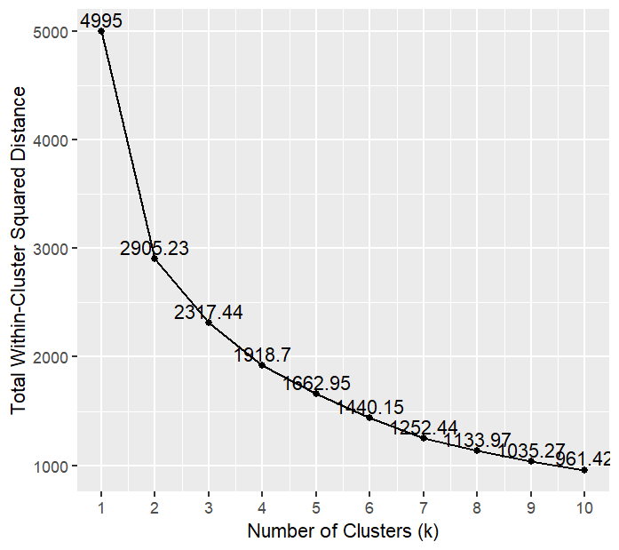
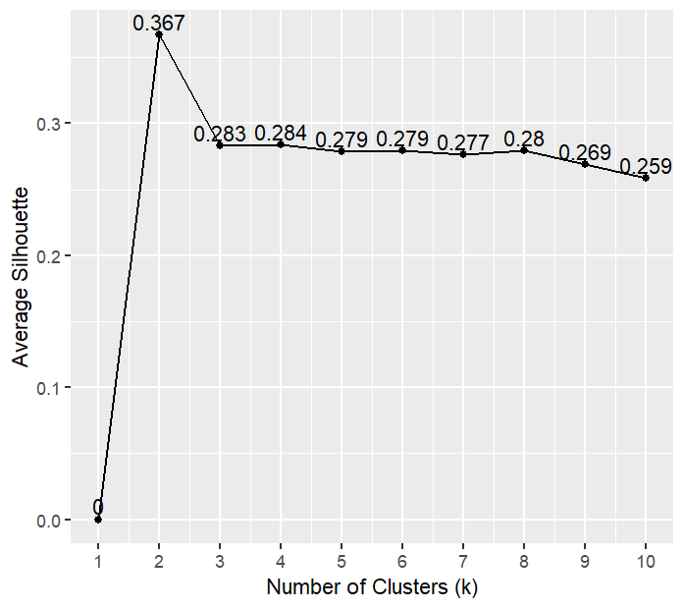
Clustering Technique
Elbow plot
Using K-means for Clustering:
Applied K-means algorithm to segment customers based on various attributes like customer type, product line, gender, income, etc.
Divide customers into distinct groups to enable targeted marketing efforts and personalized experiences.
Elbow & Silhouette Plot for Determining Number of Clusters:
Use elbow & silhouette analysis to evaluate the optimal number of clusters for segmentation.
The elbow plot Identifies point of diminishing returns in variance.
Plot silhouette scores for different numbers of clusters to assess cluster cohesion and separation.
The maximum score obtained from the elbow plot is 2. Upon cross verification with the silhouette plot, the number of clusters chosen are 2.
Silhouette plot
Notes:
1) As.factor for Branch, City, Customer, Gender, Product Line, and Payment variables to convert into categorical data type 2) To find understand the optimum number of clusters we used Elbow & Silhouette Plot Elbow- Slope Sharply changes and silhouette -typically look for a plot with a high average silhouette coefficient and relatively uniform width of the silhouette "blobs." This indicates that the clusters are well-defined and distinct from each other. If the blobs are roughly equal in width, it suggests that the clusters are well-separated. If there are clusters with significantly wider blobs, it could indicate that those clusters are less well-defined.

Slide 7
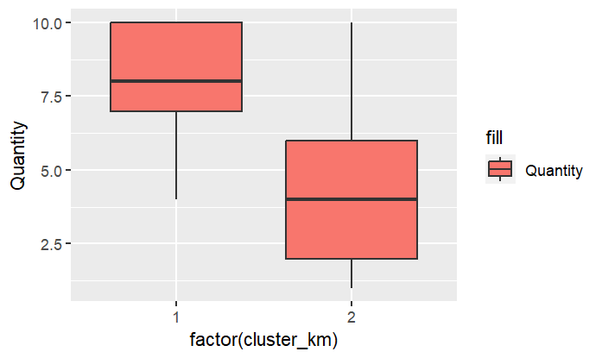
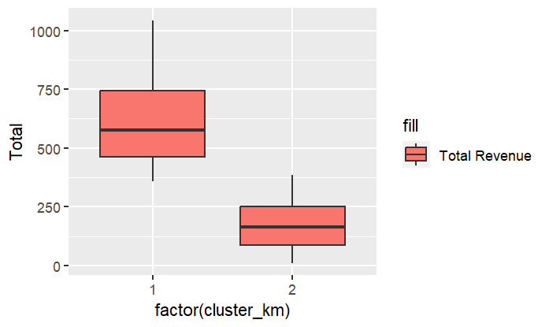
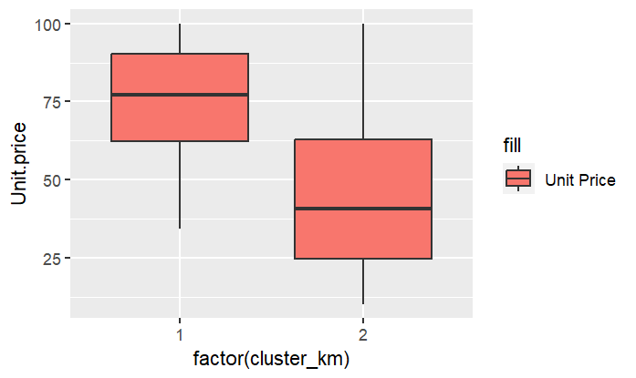
Analysis
The median total for Cluster 1 is significantly higher than Cluster 2 in Quantity, unit price, and Total Revenue.
Cluster 1 buys more items at a higher price than Cluster 2.
The length of the box plot for Cluster 1 for Total is wider.
Indicating more variability in the total revenue than in Cluster 2.
The box plot for the unit price is higher in Cluster 1 than in Cluster 2.
Indicating customers in Cluster 1 are buying more expensive products than in Cluster 2.
Cluster 1 generally has higher total figures than Cluster 2.
Notes:
1)So to just to get to know data we used box Plot due to these reasons Understanding the central tendency Visualizing the spread Comparing distributions 2) The box plots explains measure of relative standing of values with respect to meadian 3) In Qty box plot Cluster 1 shows more variability above the cluster than below the cluster which says cluster 1 people has buyed qty above the mean. While at the same time cluster 2 customers have equal qty 4) In total graph the cluster 2 has smallest spread from the median which indicates they are spending low while cluster 1 spread is larger than median. 5) In Unit Price the unit price is higher for cluster 1 still they have the highest total and qty generating most revenue.

Slide 8
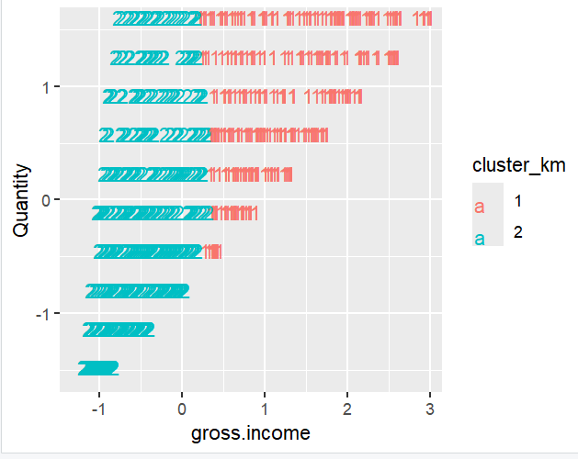
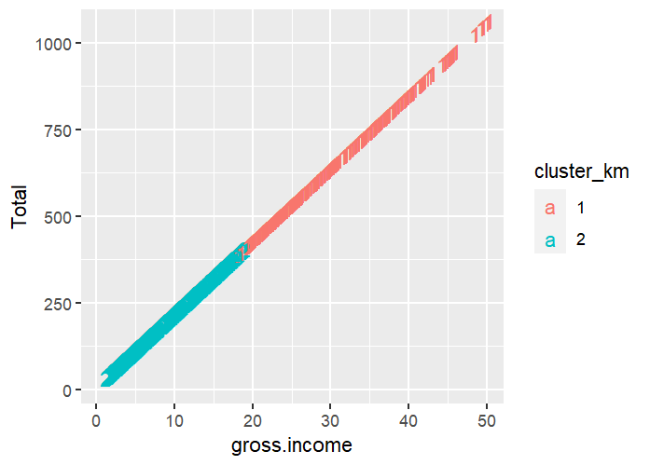
Visualization
Quantity vs Gross Income(profit)
Cluster 2 spends, while Cluster 1 spends more.
Cluster 1 contributes significantly to sales volume and revenue.
Gross Income vs Total Revenue
Cluster 1, with higher gross income, contributes more to total revenue.
Business Application:
Adjusted Marketing efforts
Better Inventory Management
Notes:
1) Both these images validate that cluster 1 is buying above a specific limit, and even though cluster 2 is buying a lot, the total income is still not equivalent. This will help us to market both groups differently with better inventory management.

Slide 9
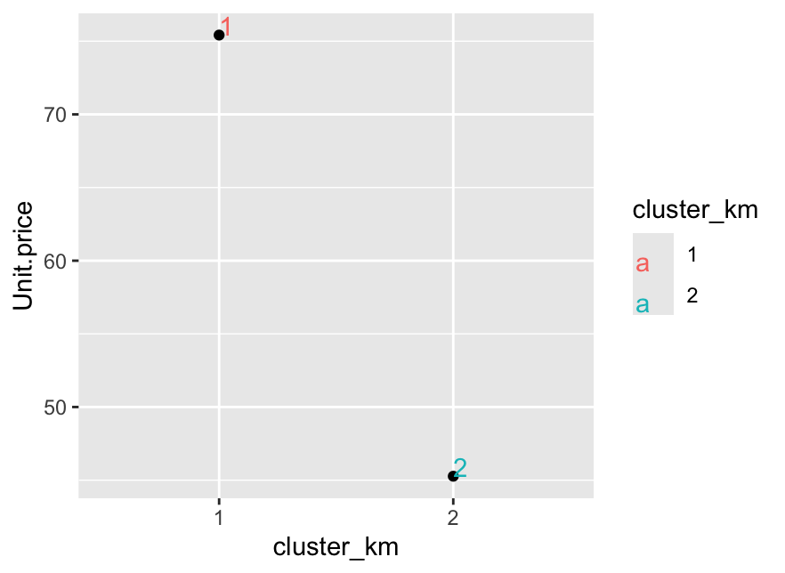
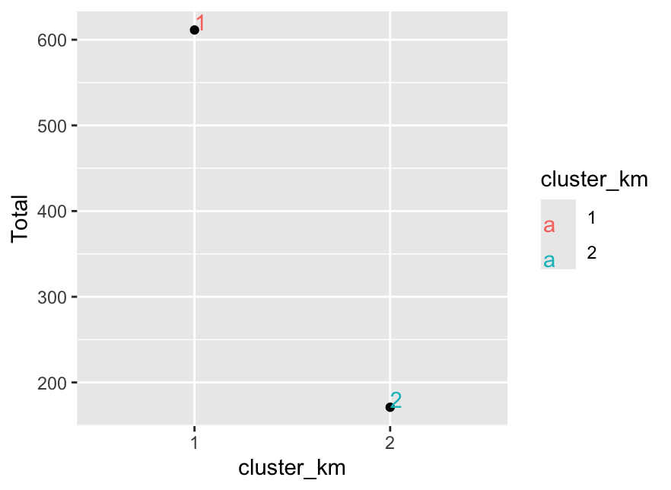
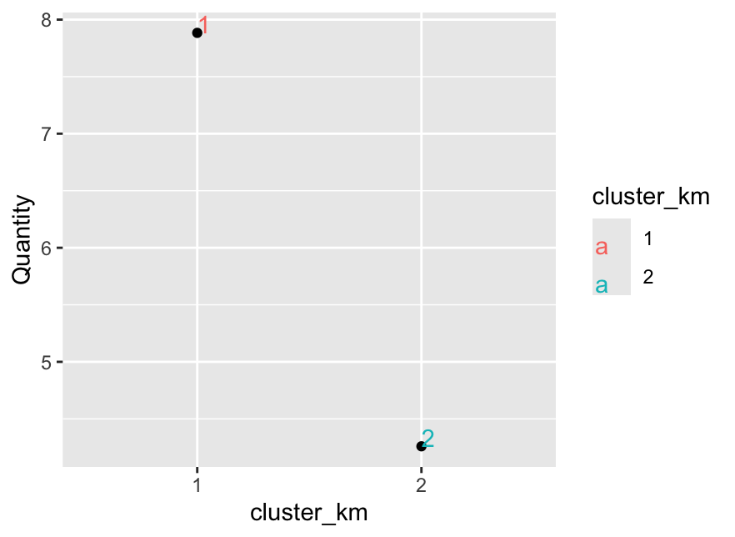
So, what’s going on?
Unit price purchased by each cluster (Plot 1):
Cluster 1 purchases products with higher unit prices, possibly premium items.
Indicates potential membership with associated benefits for premium product buyers.
Helps in niche creation and targeted marketing strategies for premium membership.
Potential for attracting new members under the 'Premium Membership' umbrella that support development of tailored marketing strategies.
Total profits & sales volumes by each cluster (Plots 2 & 3):
Cluster 1 drives higher total profits with greater sales and quantity purchased.
Cluster 2 presents opportunities for improvement and optimization.
Disparity reasons include lower sales volumes and net income in Cluster 2.
Cluster 2 may not participate in memberships or related promotions.
Analysis identifies areas for enhancing Cluster 2's contribution to profitability.

Slide 10
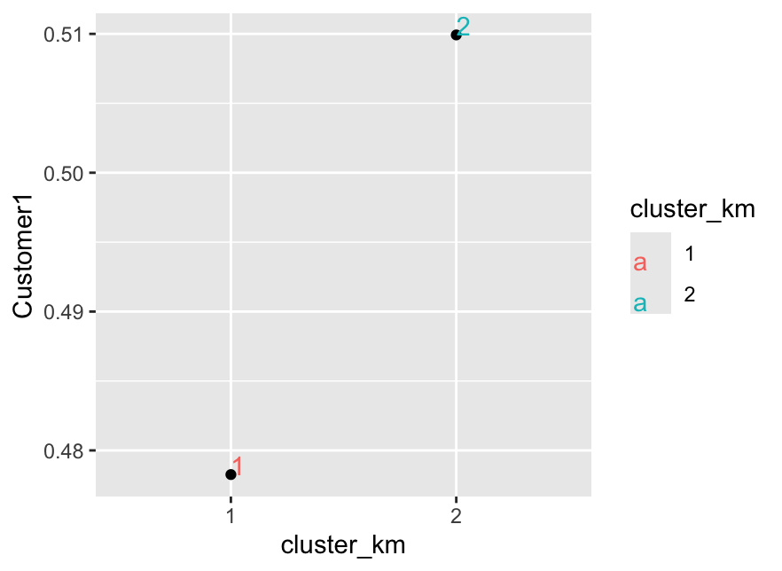
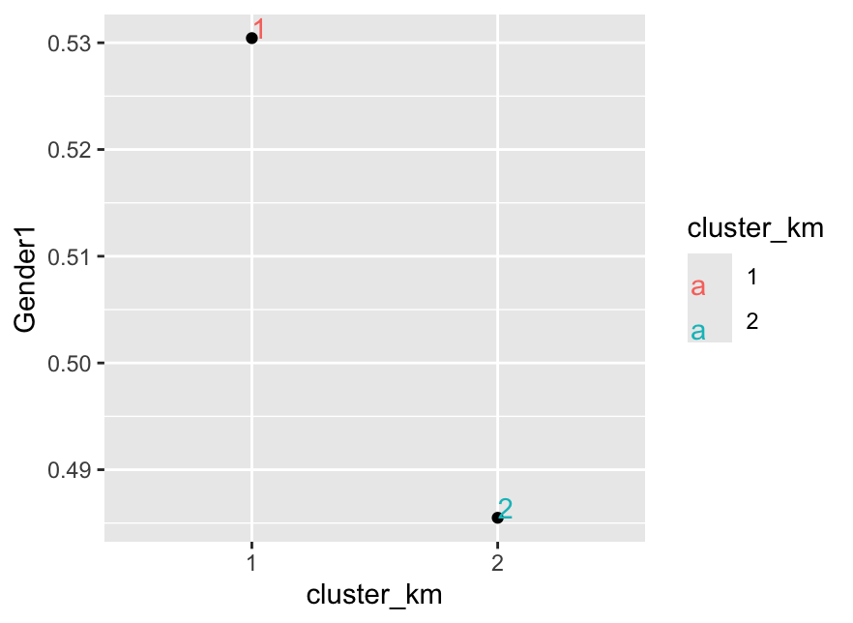
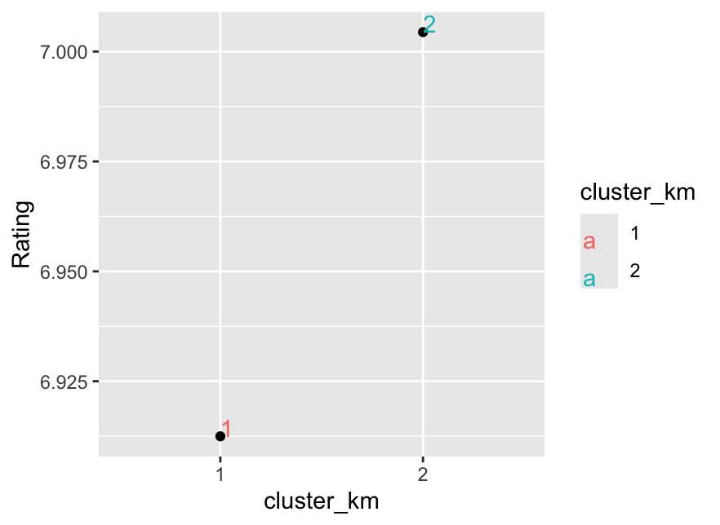
Customer Proportion (Plot 4):
Similar proportions suggest less differentiation in services provided.
Lack of differentiation may lead to poor retention and dissatisfaction.
Gender Targeted Sales (Plot 5):
Sales are similar for both clusters regardless of gender.
Indicates need for improved marketing of gender-specific products.
Strategies should target appropriate customers to enhance sales effectiveness.
Customer Satisfaction Rating (Plot 6):
Cluster 1 shows lower satisfaction rates than Cluster 2.
Premium members (Cluster 1) have similar satisfaction rates to non-members.
Improvement Areas:
Marketing strategies, reverse logistics, customer service, and member perks, etc.

Slide 11
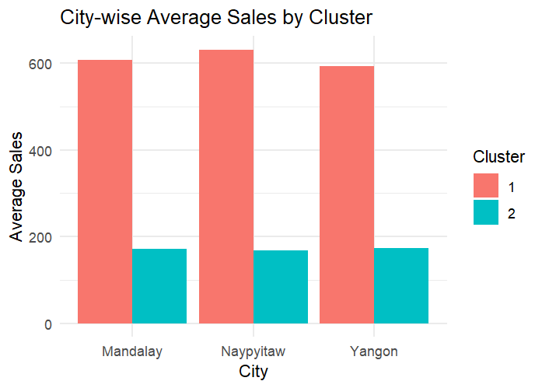
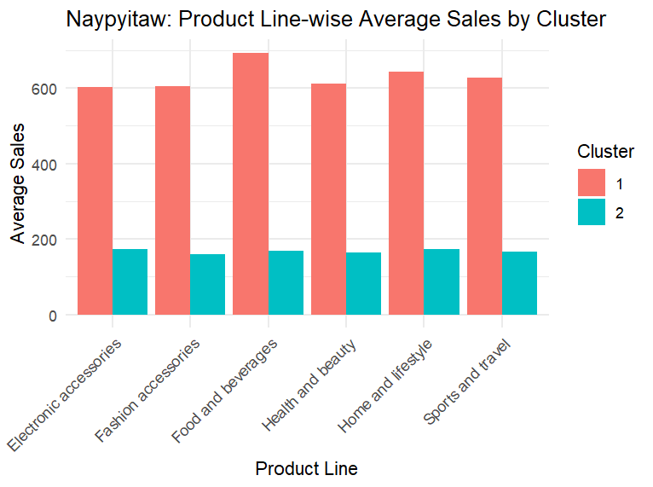
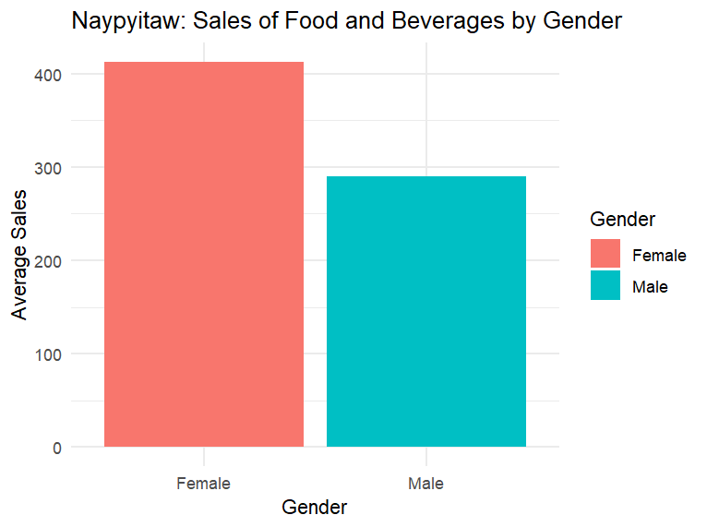
Customer Demographics
Figures are similar for both clusters within each city – Naypyitaw has the highest sales.
Clusters are likely determined by factors other than just the city, like product category or gender.
In Naypyitaw, food and beverages are selling the most compared to other categories.
More resources should go into promoting food and beverages in Naypyitaw for Cluster 1 customers.
There is no particular category that Cluster 2 prefers as the average sales are nearly identical in every category.
Female customers have a significantly higher sales figure for food and beverages in Naypyitaw.
Supermarkets should focus on women who are buying food and beverages in Naypyitaw to keep increasing sales.
Should focus on male-focused events and products to increase sales for men.

Slide 12
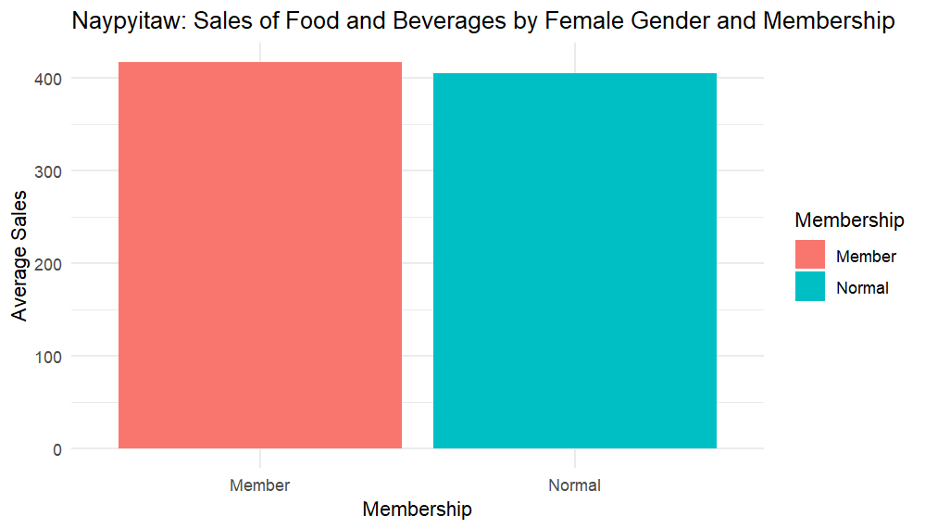
Customer Demographics
Suggestions
Should think about launching marketing campaigns to entice non-members to become members by highlighting the advantages and special offers they could receive.
Might also hold exclusive member-only events, increasing the allure of membership and raising average sales even further.
Can implement tier-based membership tiers with escalating perks to entice members to 'level up' by increasing their expenditure to maintain membership.
Should consider offering a trial membership that gives users access to member advantages for a set period.
Female customers who are members have higher average food and beverage sales than non-members, indicating that membership may be associated with higher spending, more frequent purchases, or both.
Women who have memberships in Naypyitaw purchase food and beverages the most out of every demographic group.
Non-member customers either spend less per visit, visit less frequently, or purchase less expensive items.

Slide 13
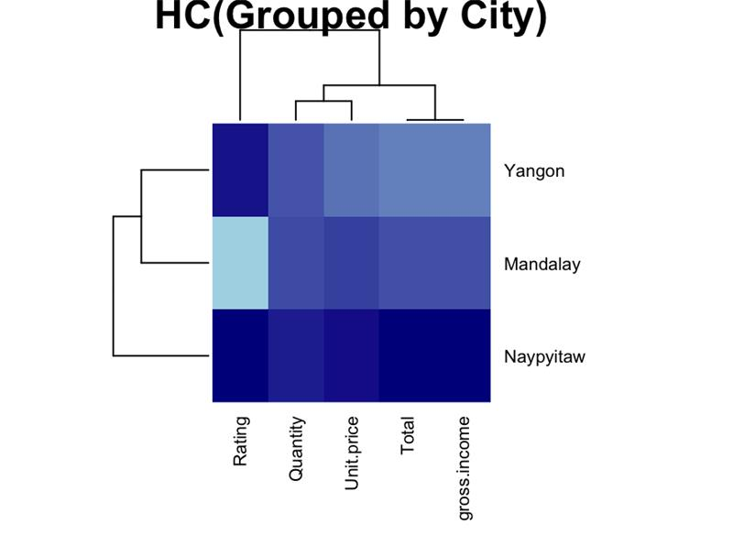
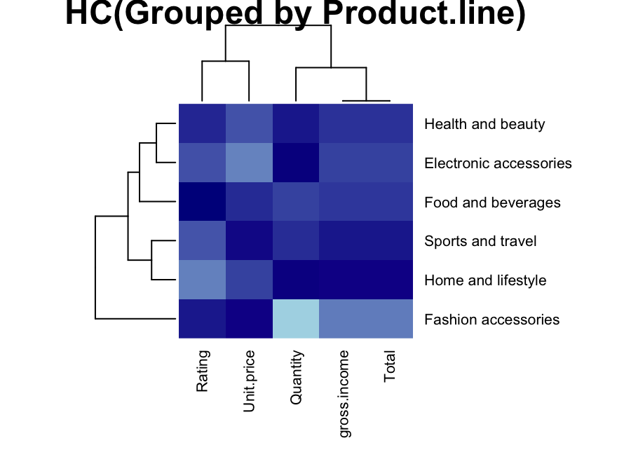
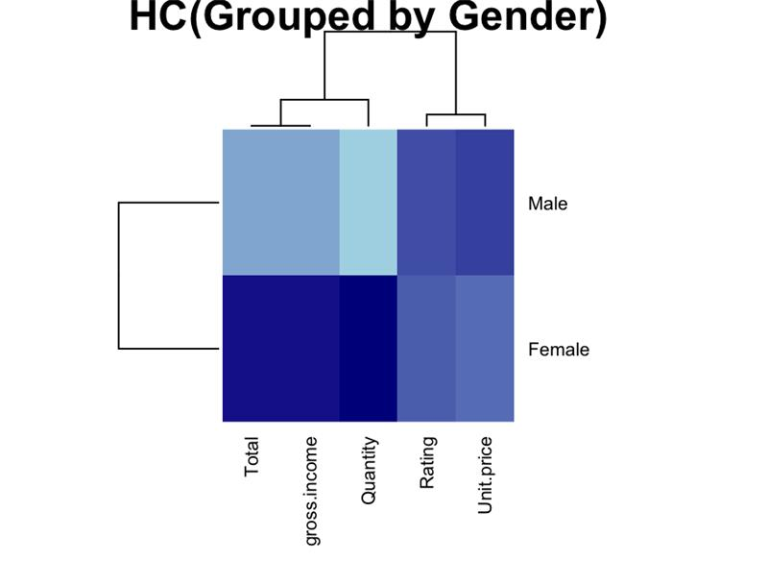
Customer Demographics
Cities
Mandlay 1) Yangon’s total income. 2) The lowest rating could be because of bad experiences and low staff.
Product.line
Fashion accessories 1) Least bought product. 2) Unit price is maximum. 3) Resulting in low income.
Gender
Male 1) Least bought Quantity. 2) Unit Price is maximum. 3) Resulting in low income.

Slide 14
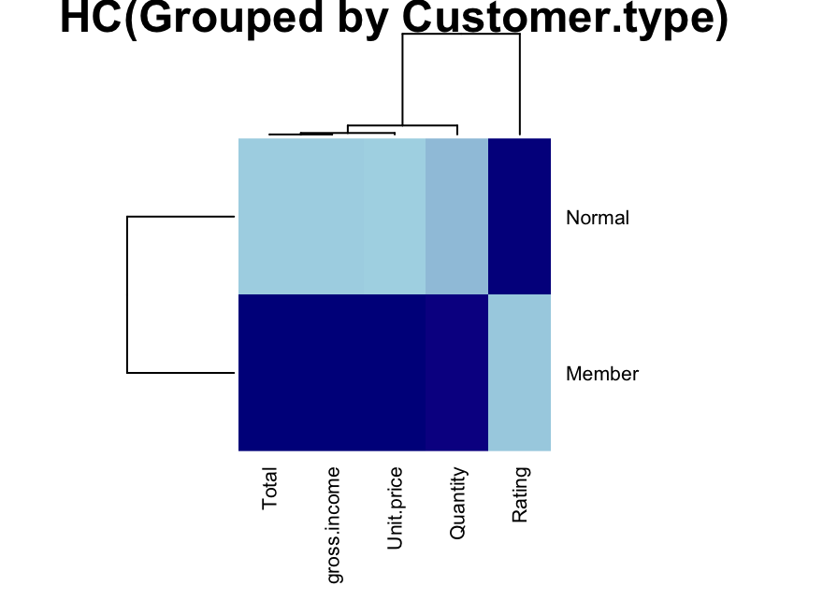
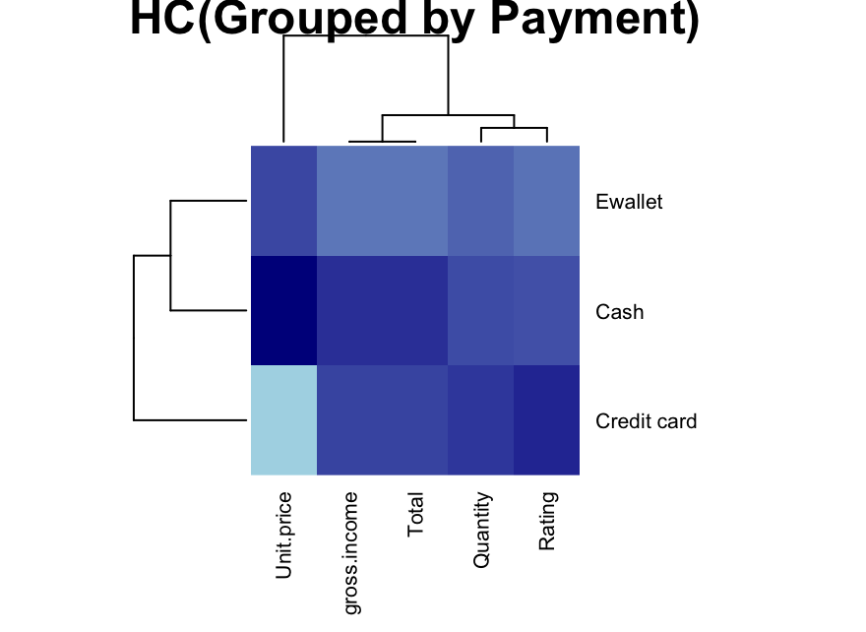
Customer Demographics
Customer Type
Member 1) Members have too high expectations. 2) The lowest rating could be because of bad experiences and low staff.
Types of Payment
Credit Card 1) Usually buy cheaper units. 2) But in huge quantities 3) Resulting in high rating.

Slide 15
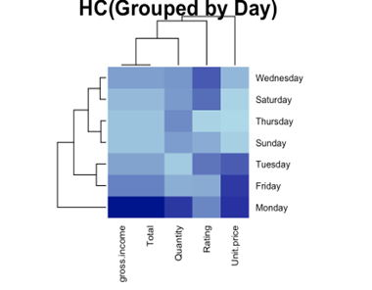
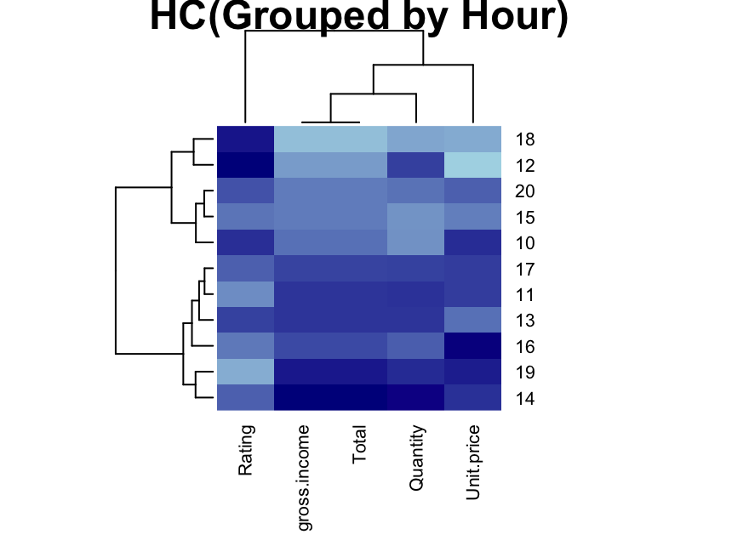
Customer Demographics
Day
Monday 1) Most bought Quantity. 2) Unit Price is maximum. 3) Resulting in max income.
Footfall by hours
Max at 14:00 & Min at 18:00 1) The max quantity bought at 14:00 resulted in max income. 2) The lowest rating could be because of bad experiences and low staff.

Slide 16
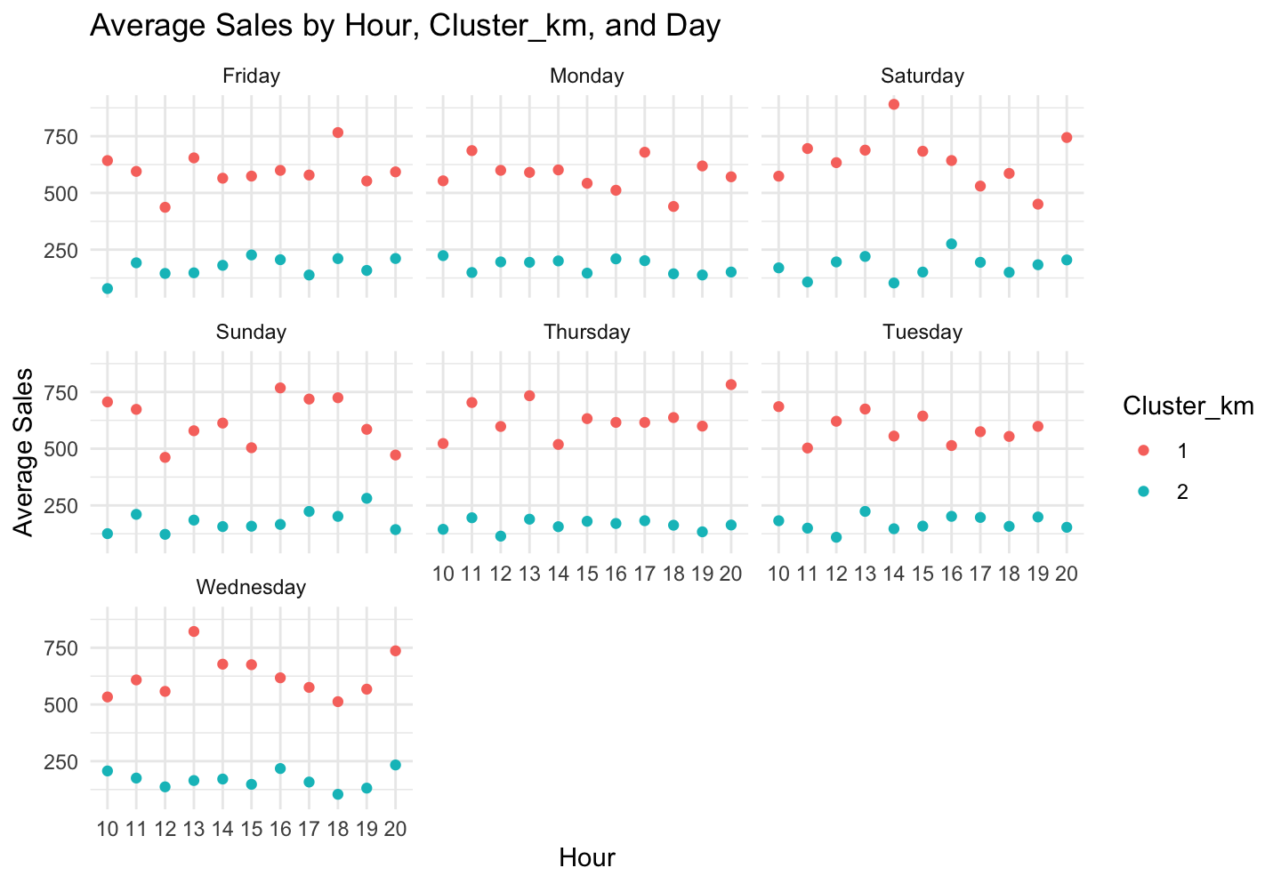
Customer Demographics
Sales consistently rise around 2 pm with a slight dip afterward, and then there is a sharp increase in sales in the evening, the time when people leave work.
To increase sales in the afternoon and morning, supermarkets can implement happy hour specials to boost sales.

Slide 17
Suggestions & Conclusion
Use of targeted marketing strategies.
Target-Market specific products.
Incentives and offers for premium customers
Same day delivery.
Express returns/improved reverse logistics.
Product discounts and offers.
Better customer service/support.
Attract newer premium customers by showing a ‘bouquet of benefits’.
Supply Chain Optimization:
Informed inventory management decisions like ordering, restocking, and storage.
Facilitate better understanding of customer trends for optimal inventory levels.
Support implementation of inventory management techniques like Vendor Managed Inventory (VMI).

Slide 18
Suggestions & Conclusion
Business Process Optimization:
Assess logistics to optimize costs and enhance efficiency.
Implement marketing strategies to attract more customers to become members.
Consider third-party logistics (3PL) providers for transportation and delivery processes.
Reduce costs associated with fleet maintenance, logistics, and manpower through 3PL involvement.

Slide 19
Thank you!

